Slide 1
Parameters | 2 | 3 | 5
Formula MW cryst syst Space group a /Å b /Å c /Å α (°) β (°) γ (°) V /Å³ Z T /K λ /Å ρ_{c} (g/cm3) μ (mm-1) Goodness of fit θ range Total reflections Unique reflections Observed data[I > 2σ(I)] R_{int} R₁, wR₂ [(I > 2σ(I)] R₁, wR₂ (all data) | C₂₂ H₁₀ F₁₀ Fe₂ N₆ O₆ P₆ 941.88 monoclinic P2₁/m 8.929(3) 22.930(8) 9.205(3) 90.00 117.449(6) 90.00 1672.3(10) 2 298(2) 0.71073 1.870 1.259 1.277 1.78 - 25.00 16193 3031 2412 0.0833 0.0883, 0.1540 0.1142, 0.1636 | C₂₇ H₁₅ F₁₅ Fe N₉ O₃ P₉ 1133.06 orthorhombic P2₁2₁2₁ 14.063(3) 15.562(3) 19.314(4) 90.00 90.00 90.00 4226.8(15) 4 298(2) 0.71073 1.781 0.809 1.173 1.68 - 25.00 40807 7451 6678 0.0772 0.0713, 0.1372 0.0810, 0.1412 | C₂₀ H₁₀ F₁₀ Fe N₆ O₄ P₆ 830.01 monoclinic P2₁/n 15.215(3) 10.924(2) 19.809(4) 90.00 109.111(4) 90.00 3111.0(10) 4 298(2) 0.71073 1.772 0.893 0.998 1.48 - 25.00 28974 5470 3236 0.0848 0.0520, 0.1024 0.1040, 0.1181

Slide 2
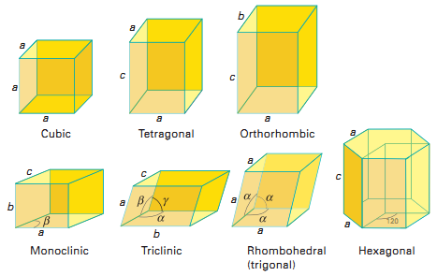
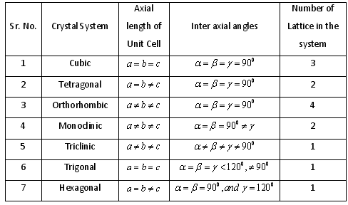

Slide 3
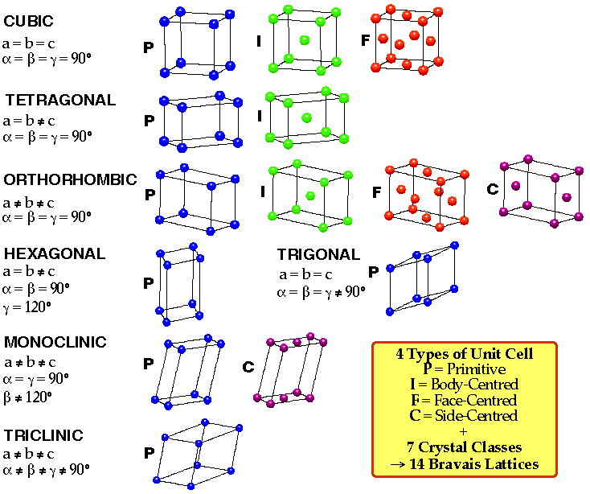

Slide 4
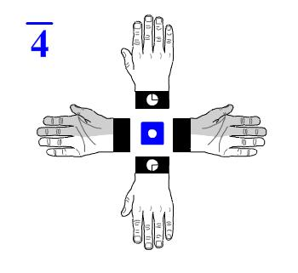
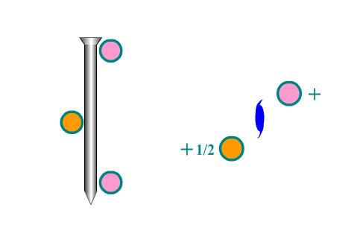
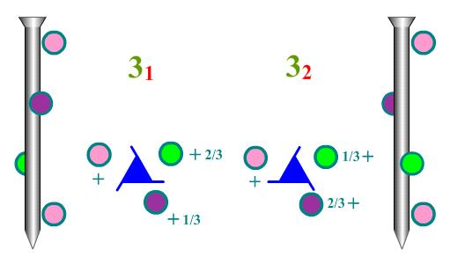
2₁
Rotary inversion
Screw Axis

Slide 5
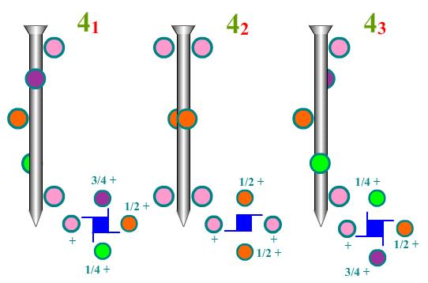

Slide 6
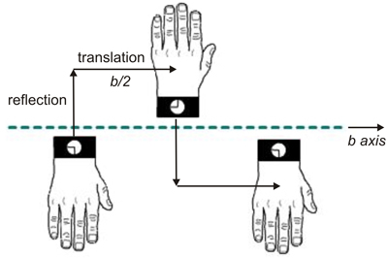
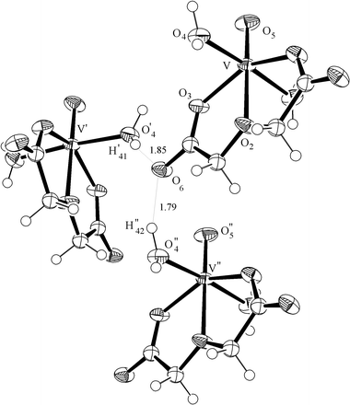
Glide Plane a, b, c, n, d

Slide 7
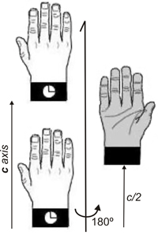
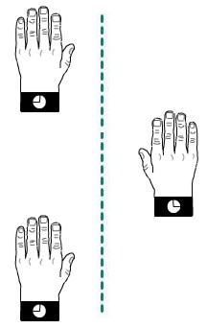
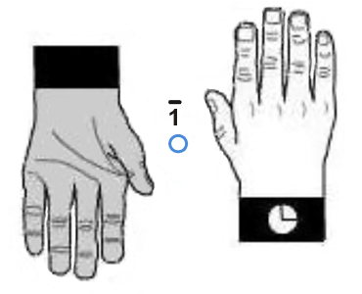
Hands (left and right) related through a center of symmetry
Twofold screw axis. A screw axis consists of a rotation followed by a translation
A glide plane. reflection followed by a translation

